Slide 1
An Introduction to Electric Energy System

Slide 2
Contents
1. Introduction to Electrical System
2. Electrical network types and classifications
3. HT supply and LT supply

Slide 3
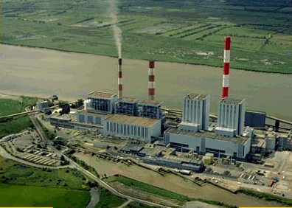

Slide 4
Principles
energy = “the ability to do work”
measured in Joules
power = rate of energy generation or use
measured in Watts = Joules / sec
current = rate of charge flow
measured in Amps
voltage = “pressure” pushing current
measured in Volts

Slide 5
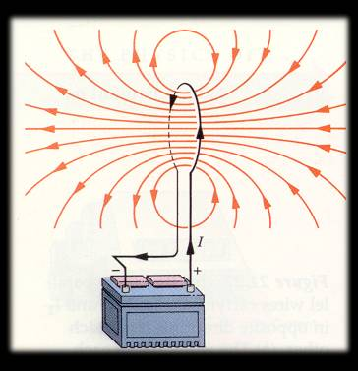
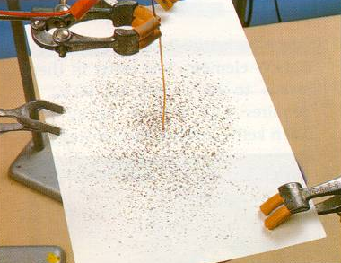
Moving Electrons Create Magnetic Fields
electromagnets
DEMO: electromagnet & compass on overhead

Slide 6
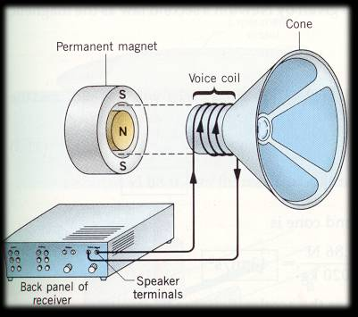
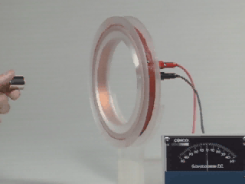
Magnetic Fields Push on Moving Electrons or moving magnetic fields push on stationary electrons
generators
speakers
DEMO: force on current apparatus DEMO: make current with magnet & coil

Slide 7
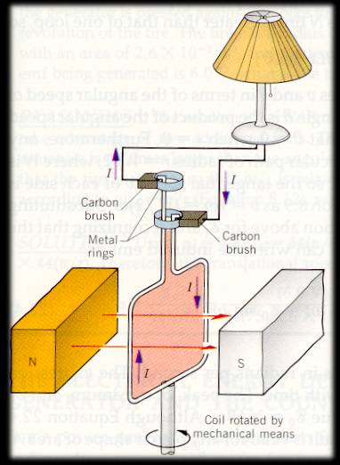
The Purpose of a Power Plant is to Turn a Loop of Wire in a Magnetic Field
Why do we need “mechanical means”?
It takes a force to push a conductor through a magnetic field — inertia won’t due.
Car alternator...
DEMO: copper tube DEMO: Genecons DEMO: Al plate and mag

Slide 8
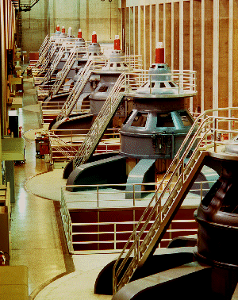
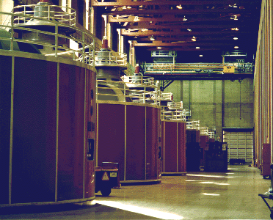
Powerhouse

Slide 9
Types of Power Plants
Classification by the “mechanical means” used to turn the generator...
Thermal (water steam by burning Coal, Oil, NG)
Nuclear (water steam by Uranium or Plutonium fission)
Geothermal
Hydroelectric (falling water)
Wind
Solar...

Slide 10
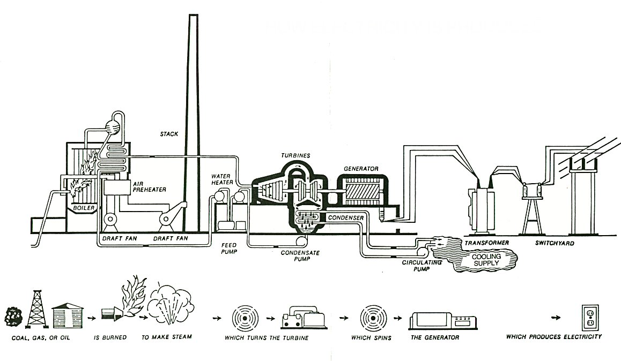
Thermal Power Plant

Slide 11
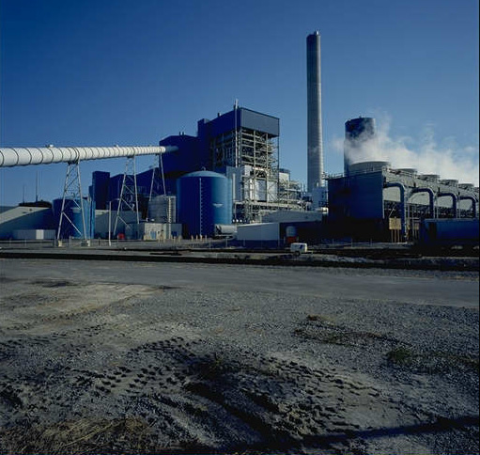

Slide 12
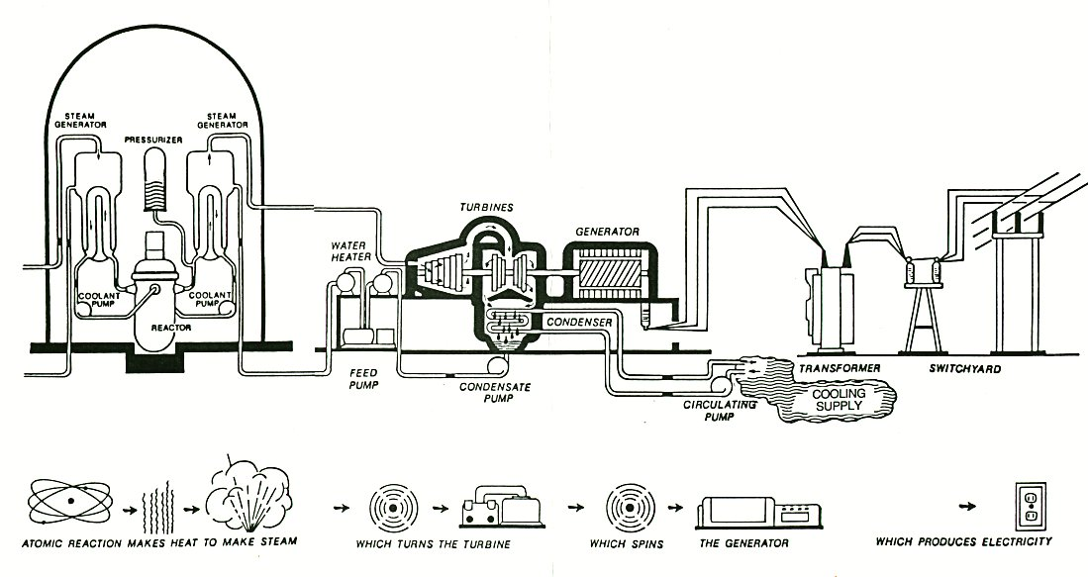
Nuclear Power Plant

Slide 13
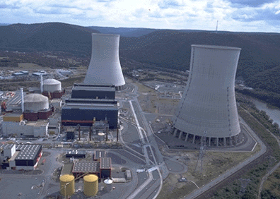

Slide 14
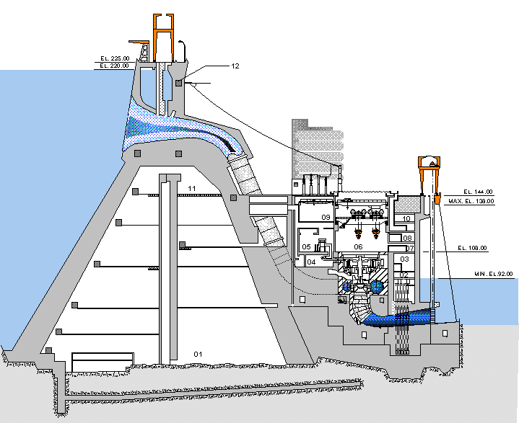
Hydroelectric Power Plant

Slide 15
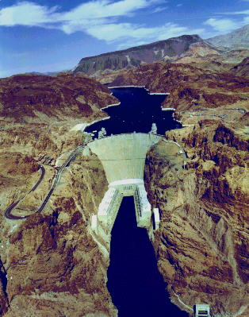
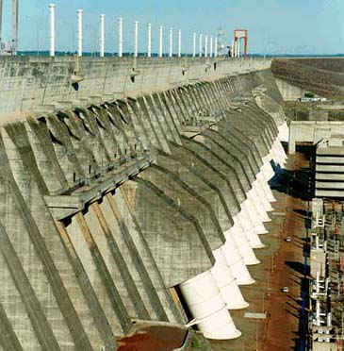
Hoover
Itaipu

Slide 16
Power Plant Components
ELECTRICAL
Generators & Turbines
Transformers
Switches
Buses
Circuit Breakers
Capacitor Banks
MECHANICAL
Conveyors
Silos
Boilers
Scrubbers & Stacks
Pumps
Cooling Towers

Slide 17
At the front end
Conveyors
Boilers
Scrubbers and Stacks
Pumps
Cooling Towers

Slide 18
Generators
The whole point of the power plant is to turn the generators to produce electrical energy.

Slide 19
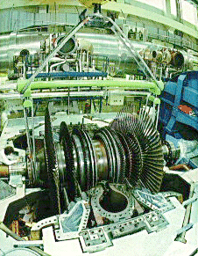
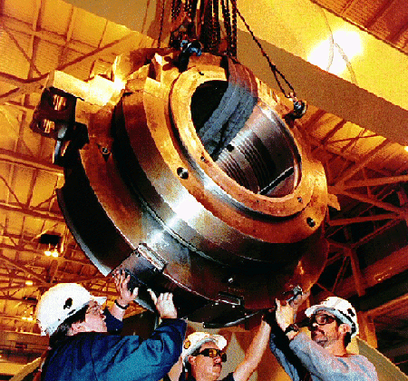
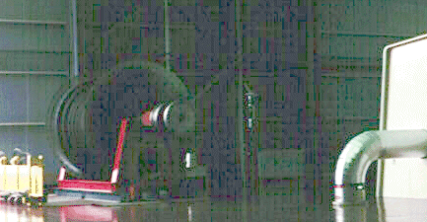
Turbines
Difficult to replace
A spare is often kept

Slide 20
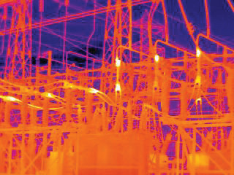
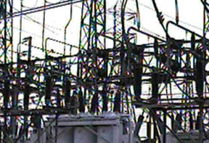
Buses
uninsulated electrical conductors
large cross-section = low resistance
must be far from ground and other components to avoid arcing
flirthermography.com

Slide 21
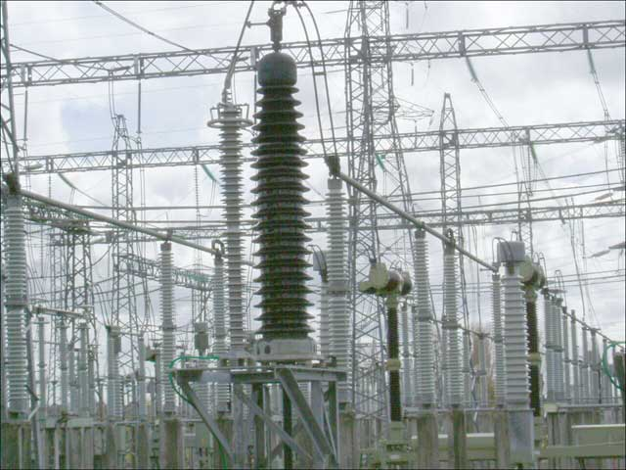
Switches & Switchyards
http://www.learnz.org.nz/trips06/images/big/b-switchyard.jpg

Slide 22
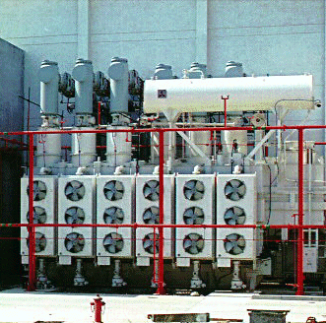
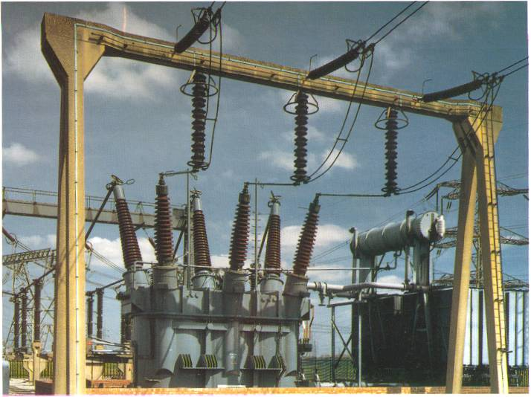
Transformers
PURPOSE: to change the voltage
increase = “step-up”
decrease = “step-down”
Often run hot, must be cooled, prone to explode.
oil inside
cooling fins and fans
blast walls
DEMO: pass around small transformer
DEMO: two coils, one with meter, other with battery

Slide 23
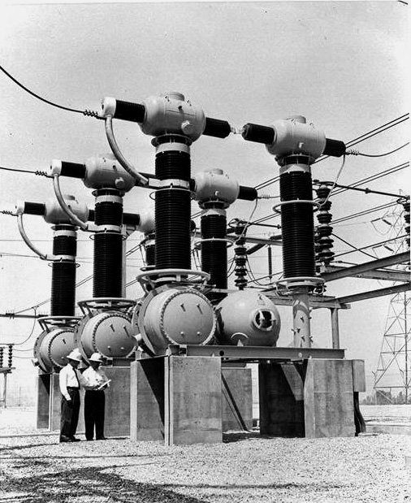
Circuit Breakers
PURPOSE: stop the flow of current if too much flows (due to short circuit or excess demand)
DEMO: blow room breaker
230 kV breaker

Slide 24
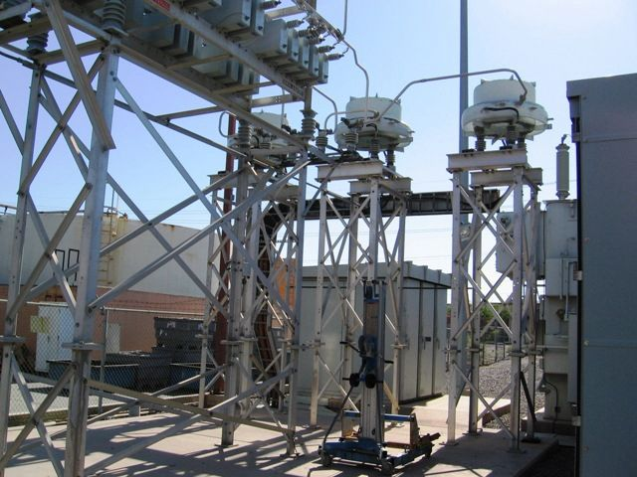
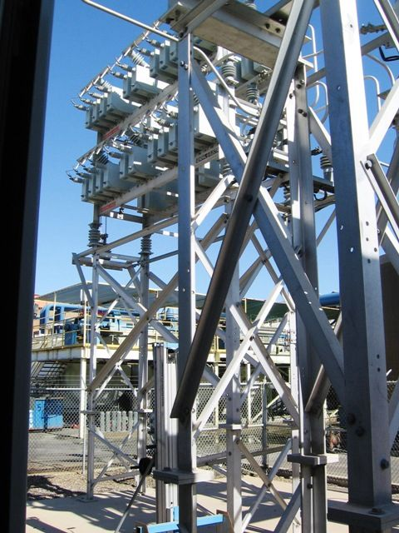
Capacitor Banks
Purpose: to smooth out spikes or “glitches” in the line voltage.
DEMO:charge/discharge a cap
DEMO:Lenz’s Law

Slide 25
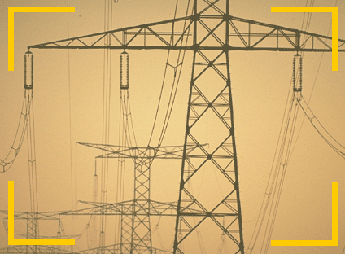
Transmission Lines
and the “grid”

Slide 26
Why are High Voltages Used?
Transmission lines typically carry voltages of 110 kV, 230 kV, or even higher. The wires are not insulated, so they are kept high off the ground and well separated from each other, to prevent arcing (sparks) and injury or people or animals.
Why use such high voltages? Using very high voltages on the transmission lines reduces the amount of energy wasted heating up the wires.
And why is that so? Transformers cannot add energy, so if the voltage is increased, the current (in amps) must decrease. The charges flowing through the wires constantly collide with the atoms, losing energy and heating the wire. We call this resistance. Recall that the power (energy per time) lost to that heating is given by the equation P=I²R. If the current is reduced, the power used in heating the wire is reduced.

Slide 27
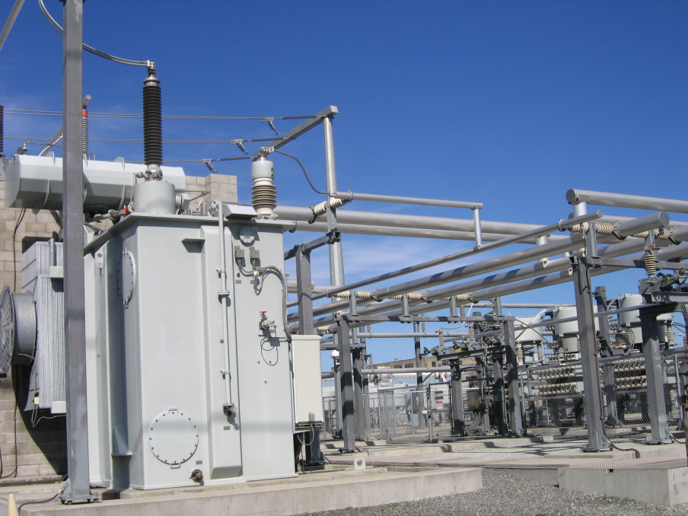
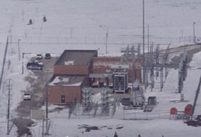
Transformer Sub-Station
Purpose:
to reduce the very high voltages from the transmission lines (>100kV) to intermediate voltages used to serve an individual town or section of a city (typically 66 kV or 33 kV)
TTR Substations, Inc.

Slide 28
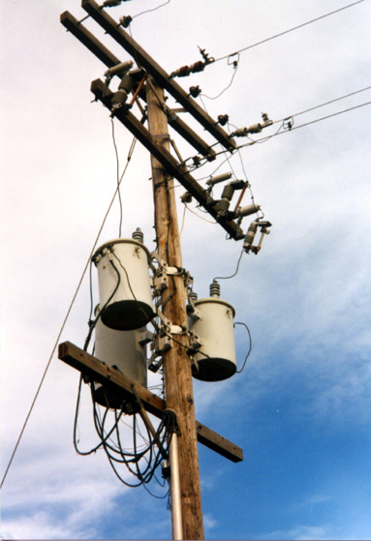
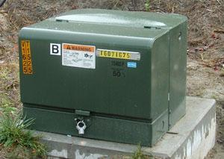
To your house...
smaller transformers (on power line poles or green boxes on the ground) reduce the voltage further to the 240V delivered to individual homes

Slide 29
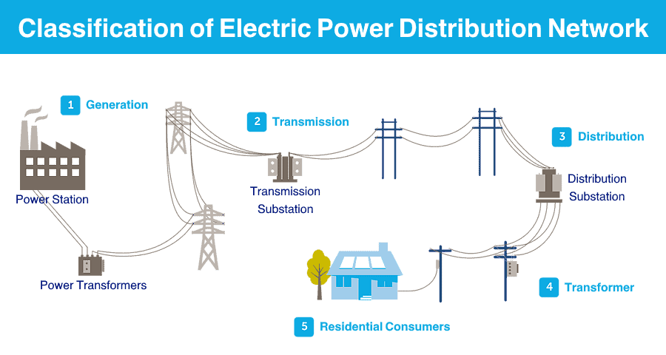

Slide 30
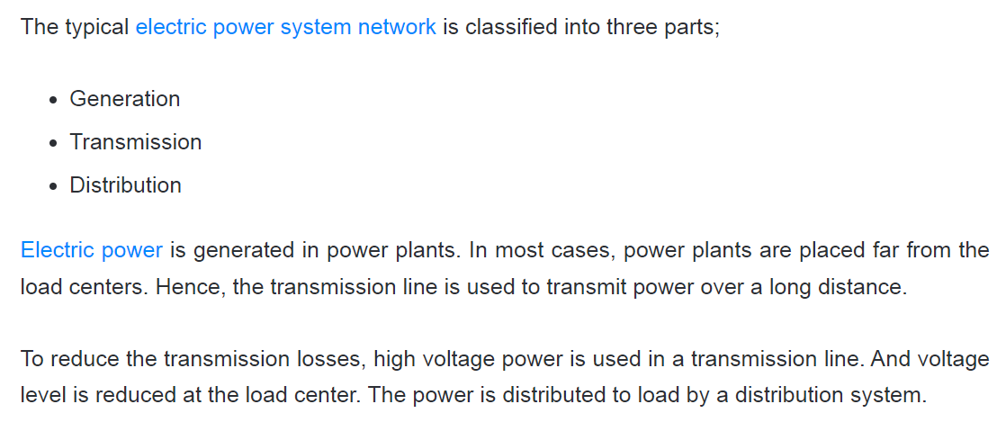

Slide 31
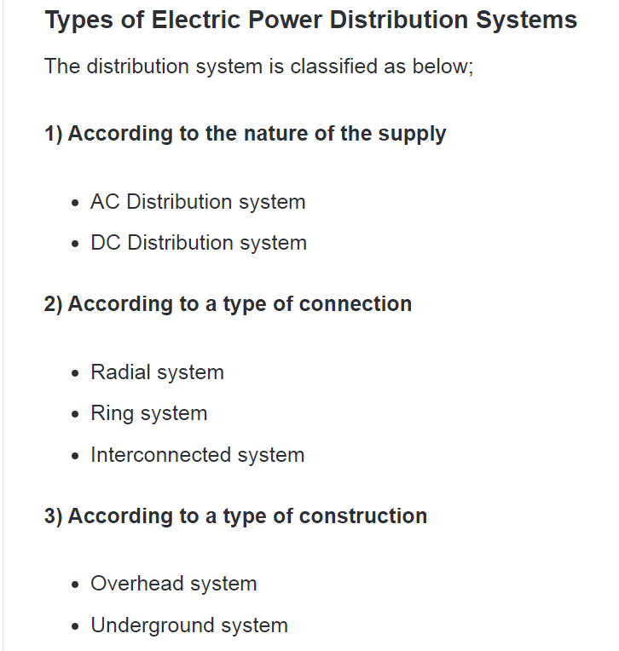

Slide 32
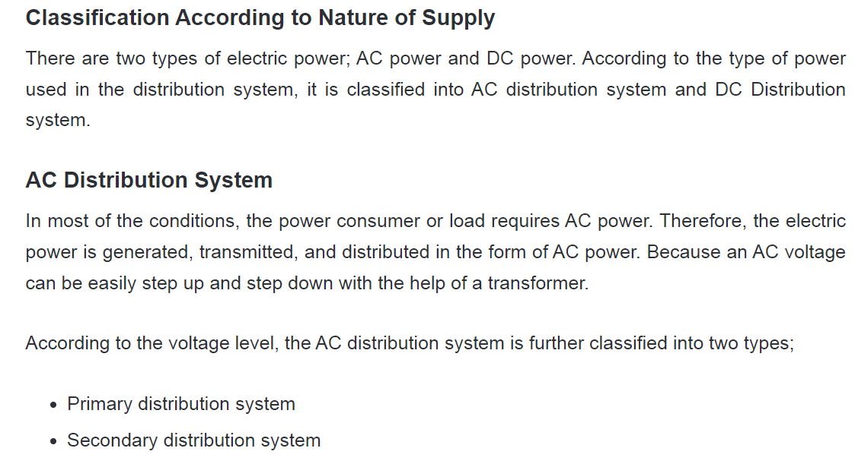

Slide 33
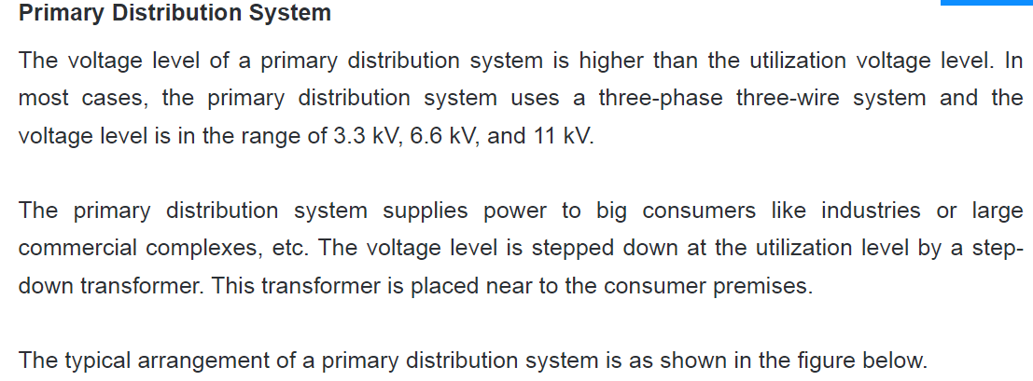

Slide 34
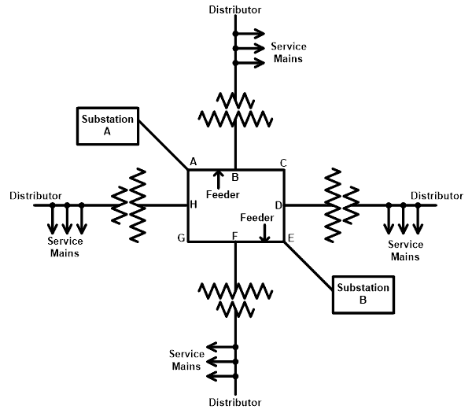

Slide 35
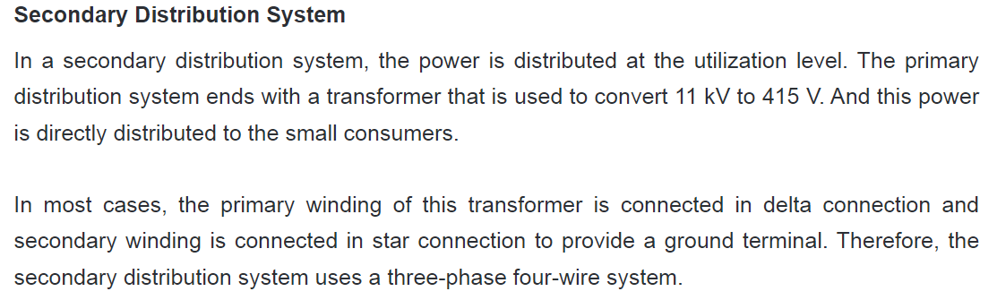

Slide 36
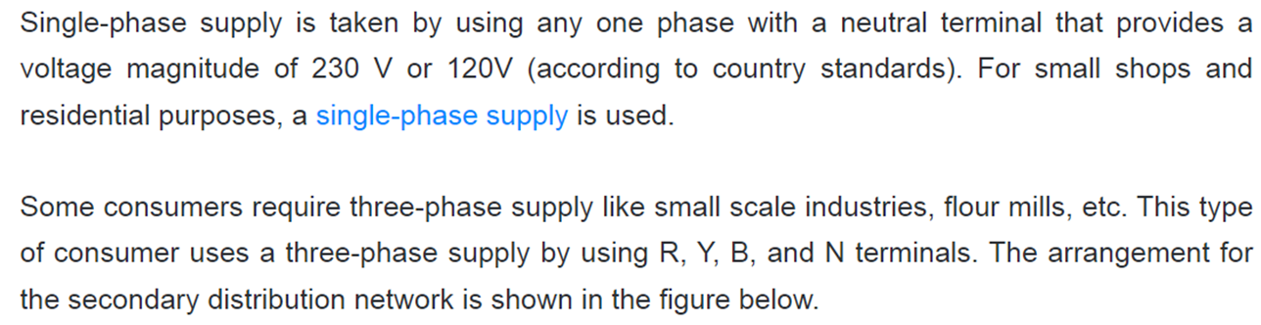
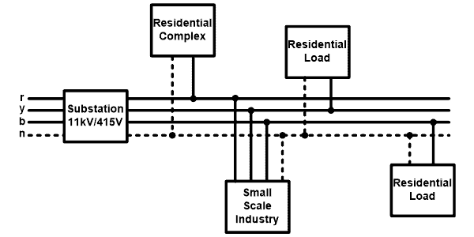

Slide 37
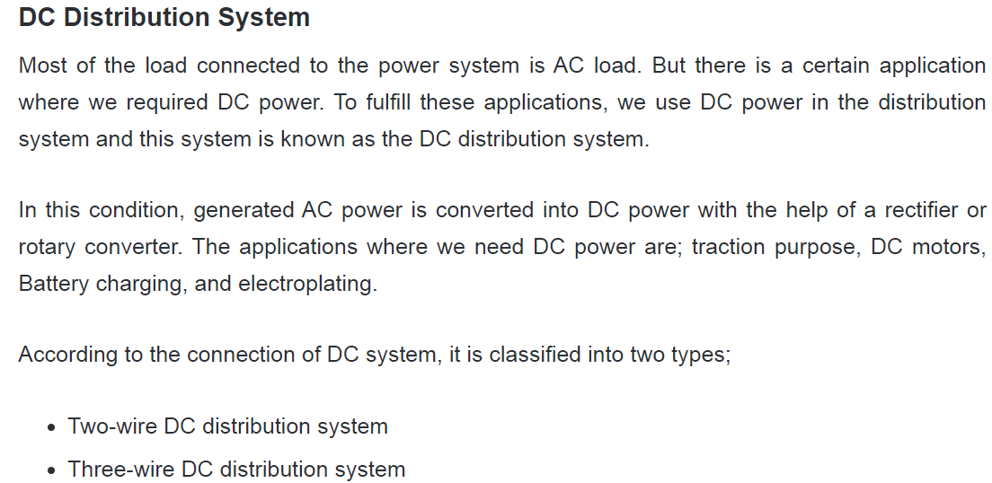

Slide 38
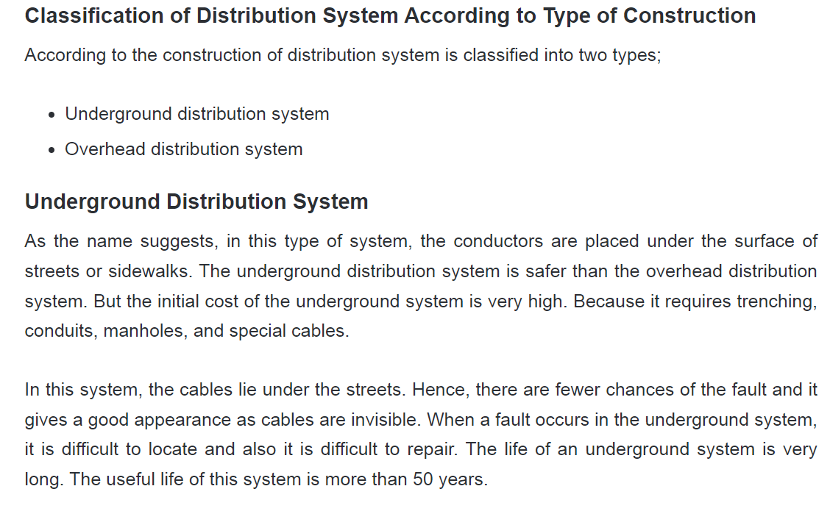

Slide 39
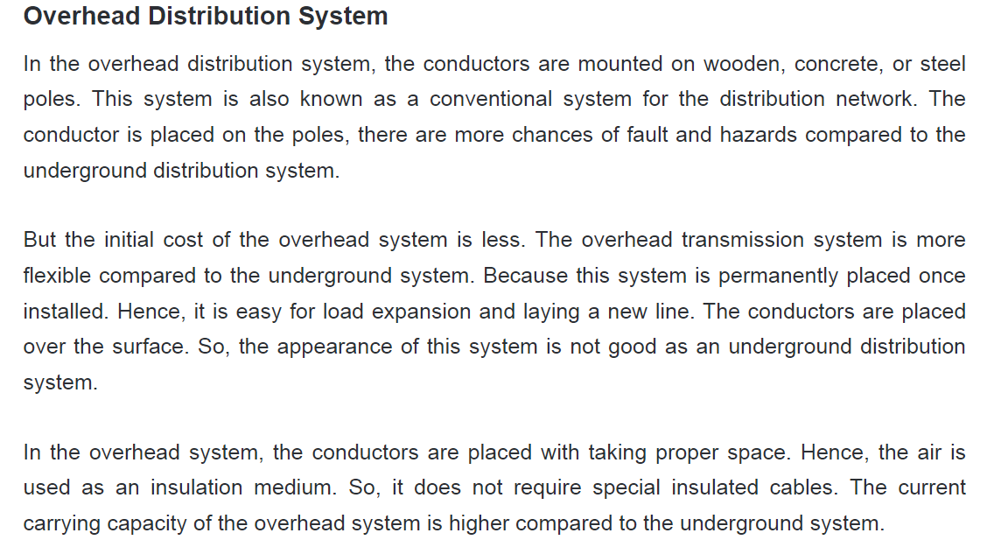
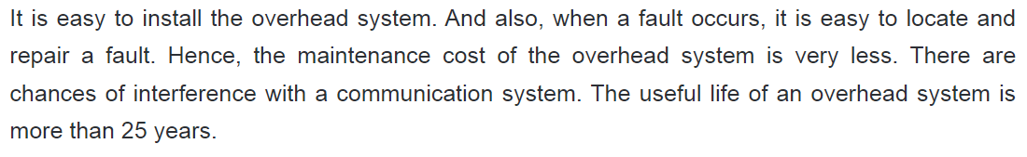

Slide 40
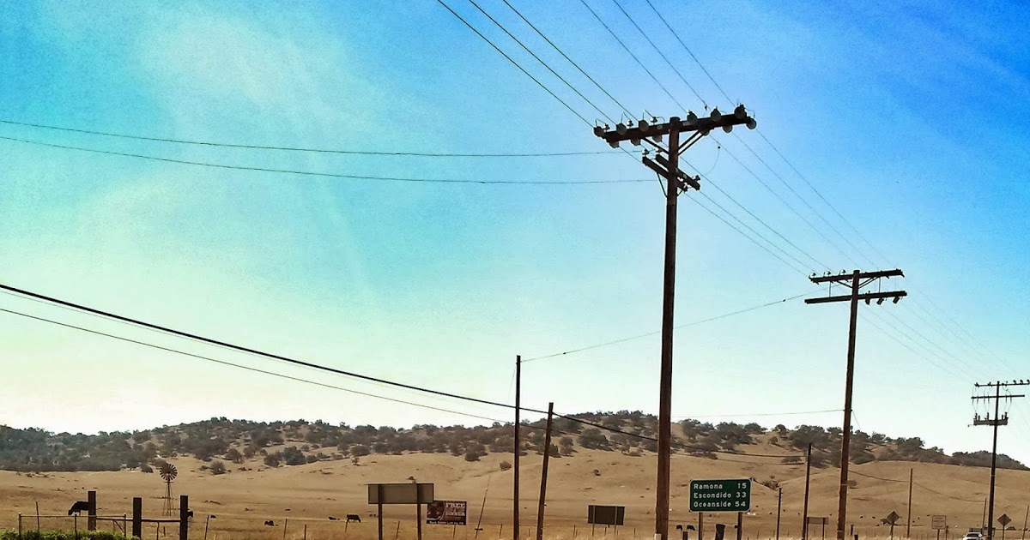

Slide 41
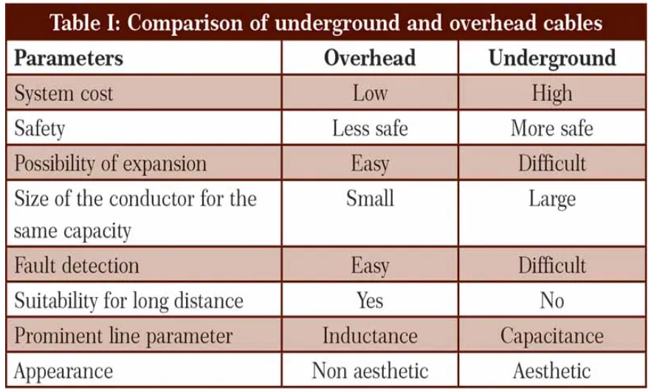

Slide 42
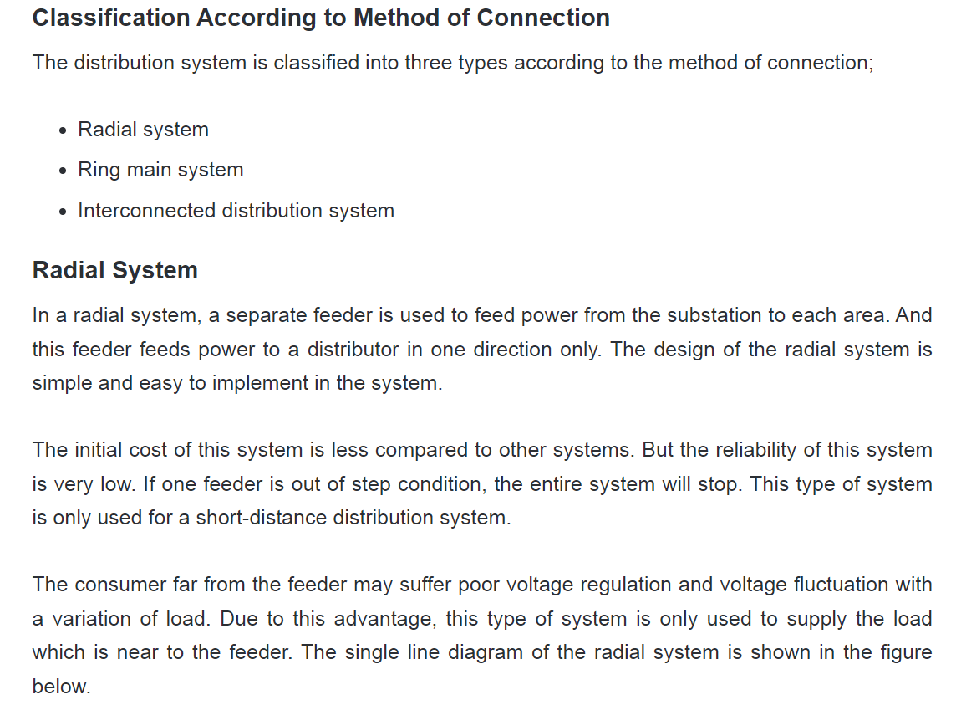
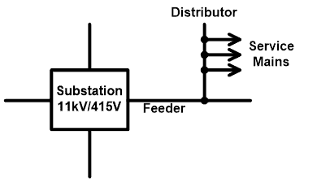

Slide 43
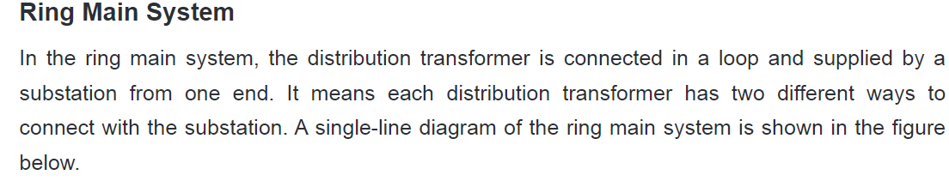
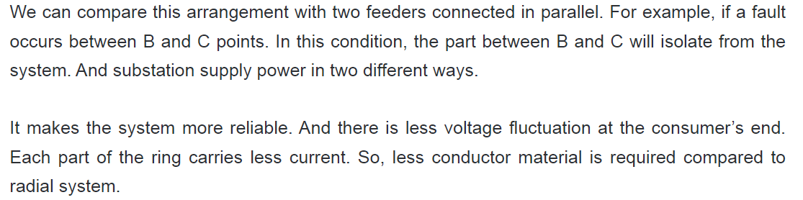


Slide 44


Slide 45
LT SUPPLY
LT line stands for low tension lines
Conductors that carry electricity from the distribution transformer structure to the consumer house.
LT line carries 440 volts line voltage(phase to phase) and 230 volts voltage (neutral to phase).
Most small consumers of electricity like individual houses, shops, small offices and smaller manufacturing units get their electricity on LT connection.

Slide 46
The types of insulators used in low tension lines are pin insulator.
Low tension lines are erected in every street of the city.
In LT lines, both PCC (plain cement concrete) and RCC(reinforced cement concrete) poles are used.
The erection cost of the low tension line is less than the HT line
In the LT line, four conductors are used such as three conductors for phase and one for neutral.

Slide 47
HT SUPPLY
HT line stands for high tension lines
conductors that carry electricity from substation to distribution transformer.
HT line carries 11 KV voltage.
In the HT line, three conductors are used for phase (R, Y, B).

Slide 48
Insulators used in high tension lines are pin insulators and disc insulators.
High tension lines are erected at main roads generally.
In HT lines also PCC and RCC poles are used.
In HT The erection cost of high tension line is more than the cost of LT line.

